Slide 1


Slide 2
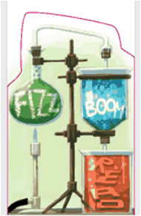

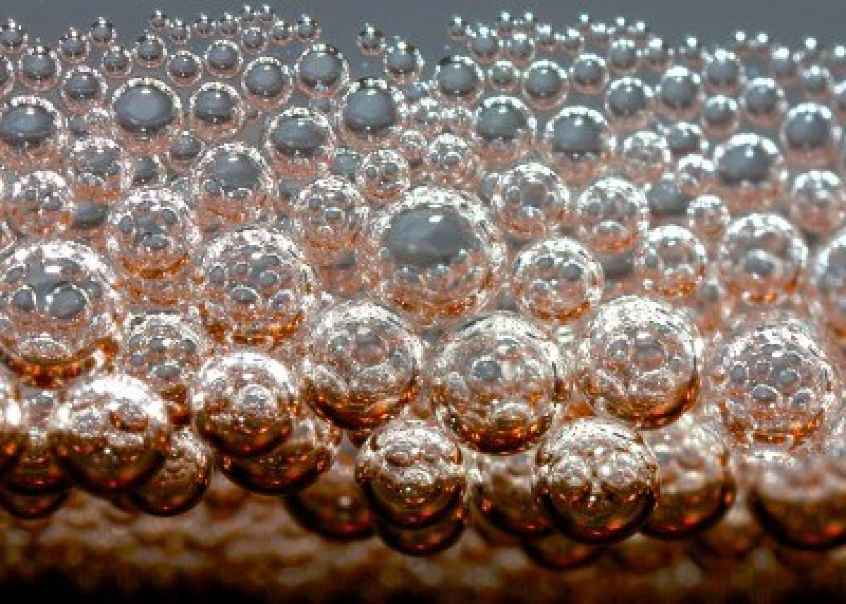

2014
Florida Library Youth Program
Workshop
fizz
BOOM
READ!

Slide 3

fizz
We’re all born scientists!
BOOM
READ!

Slide 4

Constantly testing our boundaries.
fizz
BOOM
READ!
Insert
phrase
here.

Slide 5

Learning how to maneuver life.
fizz
BOOM
READ!

Slide 6

If we apply what we know about the science of learning to our programming… then it will be… laehgiaoihefjgiha
fizz
explosive!
BOOM
READ!

Slide 7
Multiple Intelligences, and
Multiple Learning Styles:
Existential:
learns by seeing the ‘big picture.’ Connects real world understandings and application to new learning.
Verbal-Linguistic:
learns through spoken and written words: reading, listening, speaking and writing.
Mathematical-Logical:
learns through reasoning and problem solving; relates through numbers.
Naturalist:
learns through classification, categories and hierarchies; has the ability to pick up on subtle differences.
Bodily, Kinesthetic:
learns through interaction with one’s environment and personal experience.
Musical
learns through songs, patterns, rhythms, instruments and musical expression.
Interpersonal:
learns through interactions with others, working collaboratively and cooperatively.
Intrapersonal:
learns through feelings, values and attitudes; understands others well.
Visual-Spatial:
learns visually by organizing ideas spatially: thinks in images and pictures; ‘sees’ things in one’s mind.

Slide 8
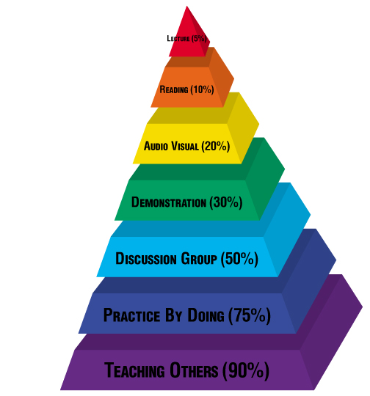
What Do All We Get From This?
The Learning Pyramid:
fizz
BOOM
READ!
Lecture 5%
Reading 10%
Audio Visual 20%
Demonstration 30%
Discussion Group 50%
Practice By Doing 75%
Teaching Others 90%

Slide 9
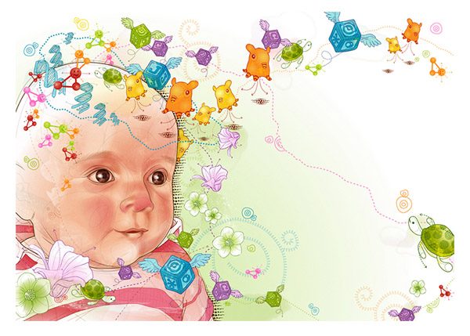
Stages of Brain Development in Infants:
Age in Years
3
conception
5
0
1
2
4
6
Vision
Speech
Emotional
Math, Logic
Social Attachment & Skills
Motor
Peer Social Skills
Language

Slide 10
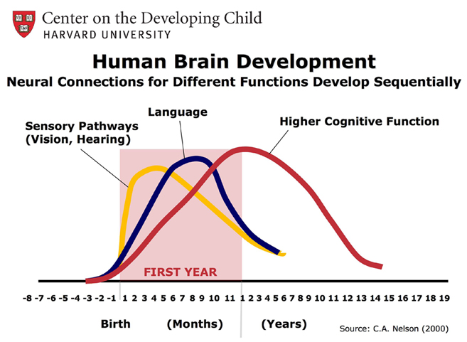
fizz
Brain Development of Infants
BOOM
READ!

Slide 11

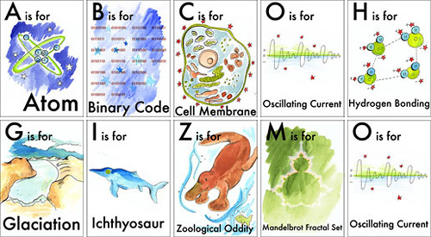

fizz
The Wonder of Science
For the Young and Old:
fizz
BOOM
BOOM
READ!
READ!

Slide 12
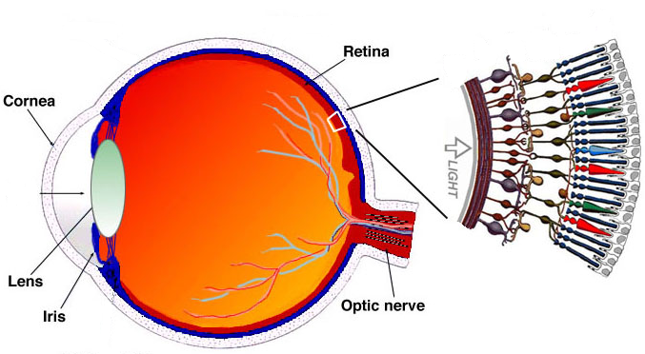
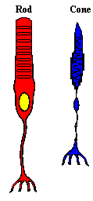
The Science of Seeing:
fizz
BOOM
retina
cornea
READ!
pupil
lens
iris
optic nerve
Rods and cones are special cells that process light.
Rods and cones are extremely small. In fact, there
are about 120 million rods and 7 million cones in
each eye! Rods help us see black, white, and shades
of grey, while cones help us see millions of colors!

Slide 13
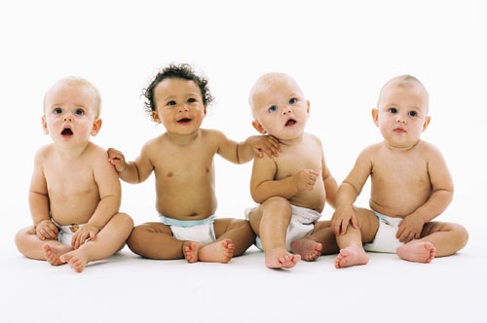
fizz
BOOM
READ!
All babies are born color-blind. To a newborn, the world looks black and white. Around four months of age is when our cones begin to develop and allow us to see in color!

Slide 14
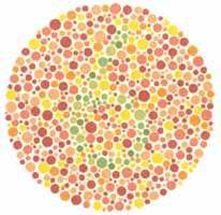
fizz
BOOM
READ!
Infants, as well as people with red, green color-blindness, cannot see a number hidden in these dots. Can you? What number do you see?

Slide 15
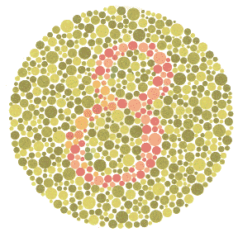
fizz
BOOM
READ!
How about now?
If you are red, green color-blind,
you will see the number 3 instead of 8.

Slide 16

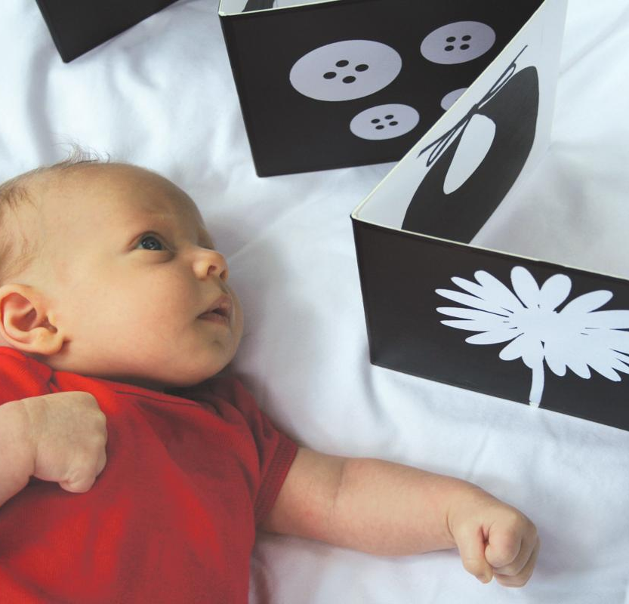
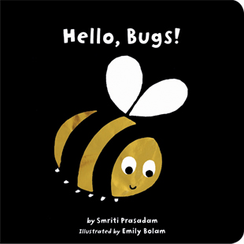


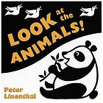
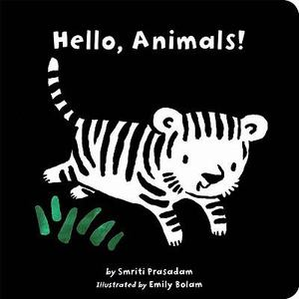
This is why simple, high contrast images like these black & white board books are recommended for the very young.
Pass it on!

Slide 17




fizz
Infant iPad App:
Available @ the
Apple App Store
BOOM
READ!
Commind AB
Dotty
Developer’s Description:
Newborn children have limited eye sight and can’t make out colors the same way adults can. At 1 month they can make out contrasts between colors, and between 2 and 4 months, they start being able to learn the difference between similar colors and shades.
Babies prefer bright colors and contrasts. They tend to like warm colors like red, orange and yellow more than cooler colors like blue, purple and green. Light pastels are generally not interesting for babies.
iPad app for infants

Slide 18
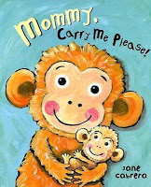




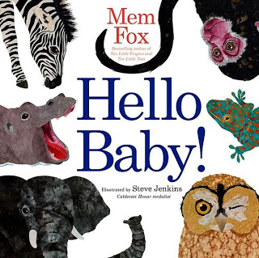

fizz
BOOM
READ!
Emotional Development: Mommy & Baby!

Slide 19


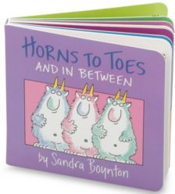

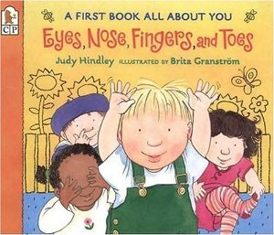


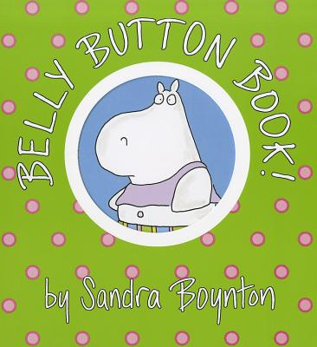
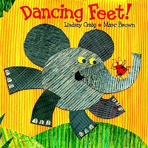

fizz
Sensory Development:
Baby’s Parts
BOOM
READ!

Slide 20

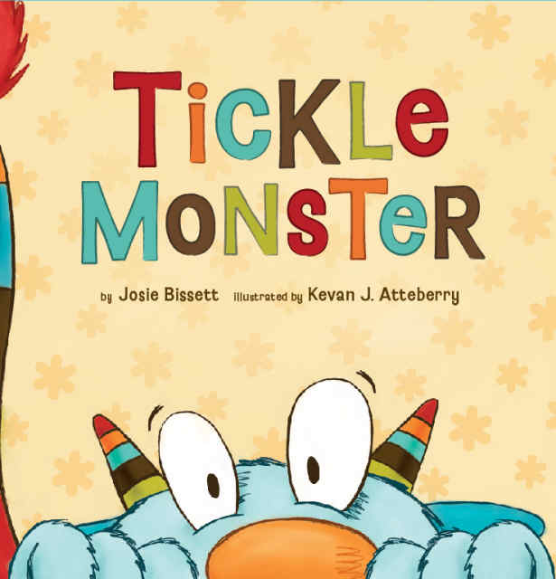
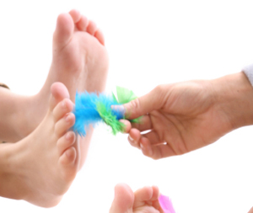
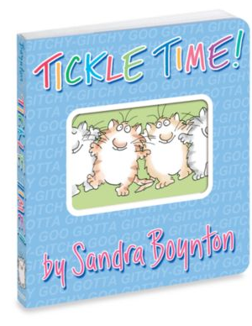
fizz
Appeal to
Their Senses!
Get Tickled
with Touch
BOOM
READ!

Slide 21
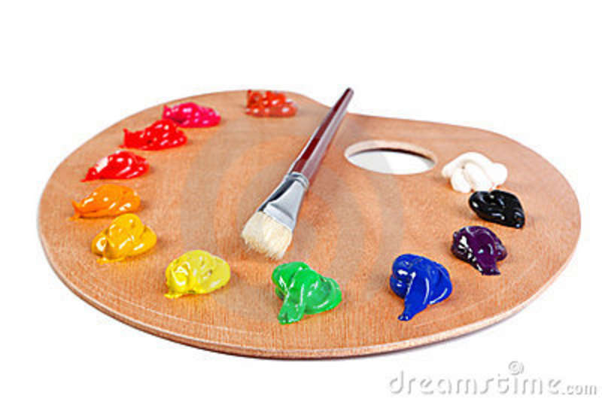
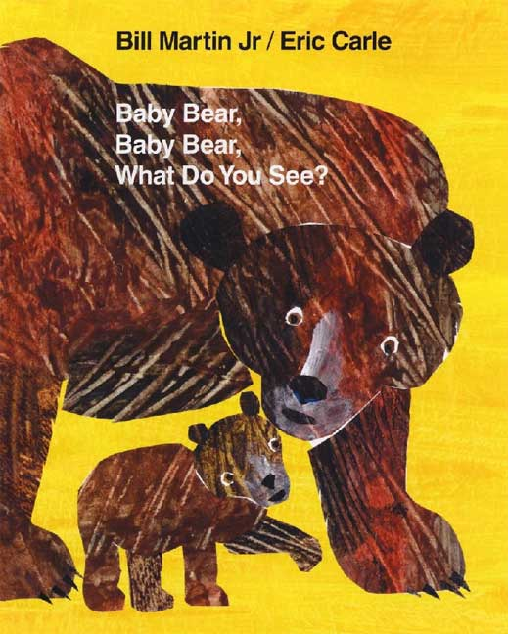


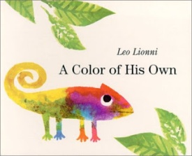
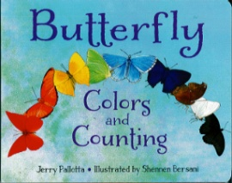
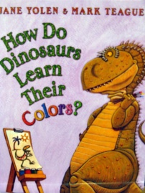

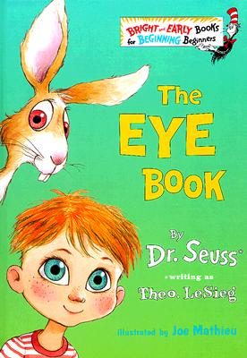

fizz
Appeal to
Their Senses!
Color their World
BOOM
READ!

Slide 22
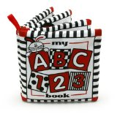
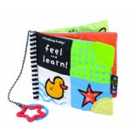
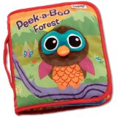
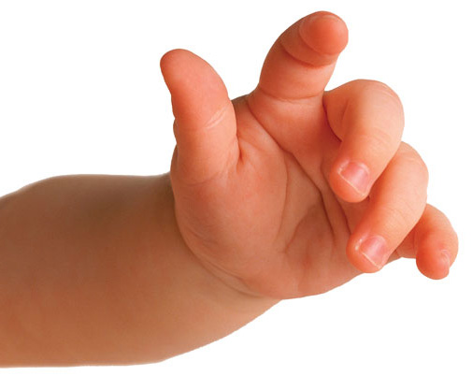

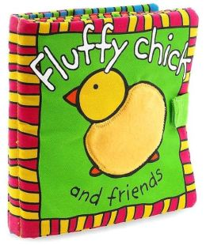
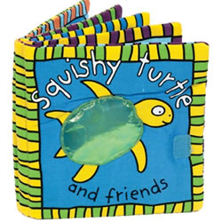
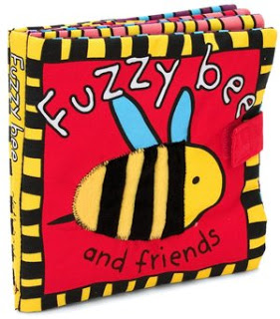
fizz
Appeal to Their Senses!
Touchy-Feely Titles
BOOM
READ!

Slide 23




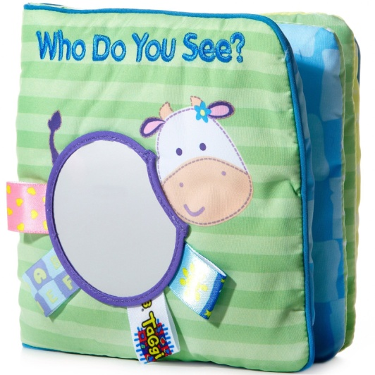
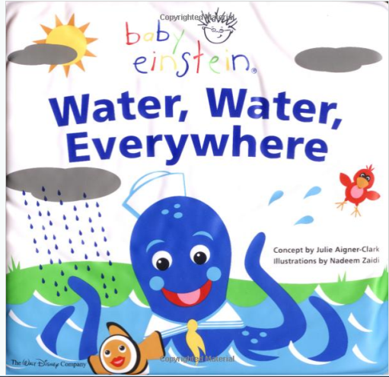
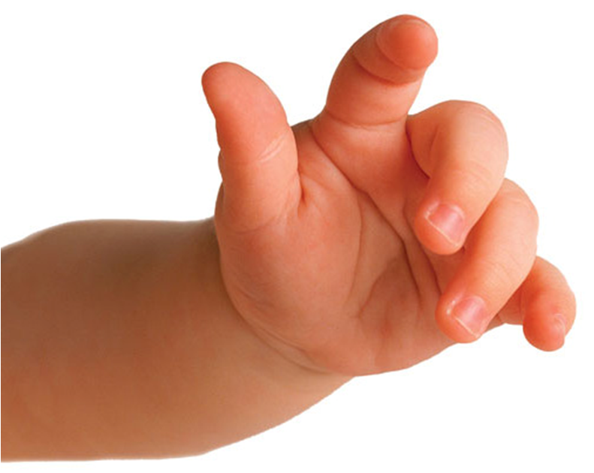
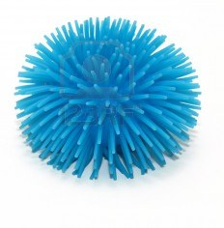
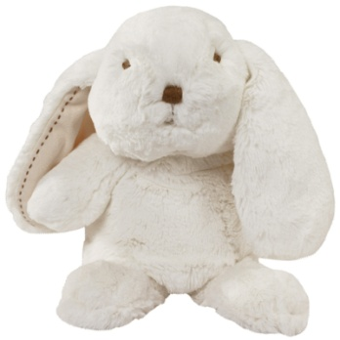

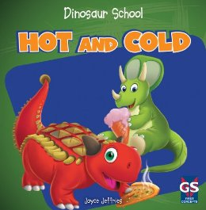
fizz
Appeal to Their Senses!
Touchy-feely Titles
BOOM
READ!

Slide 24

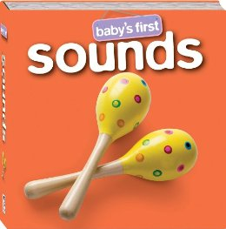




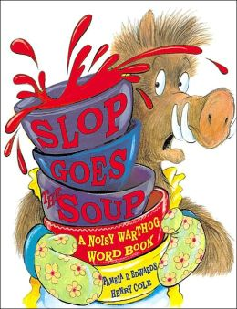

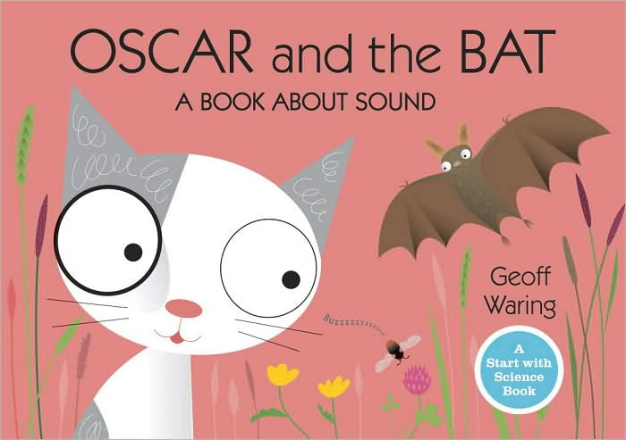


fizz
BOOM
READ!
Appeal to Their Senses!
Noisy Reads

Slide 25

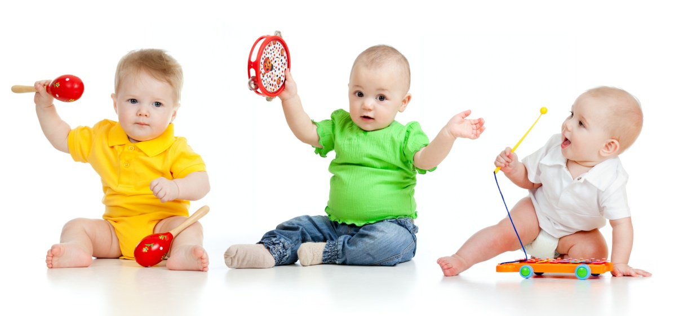
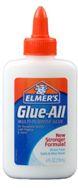
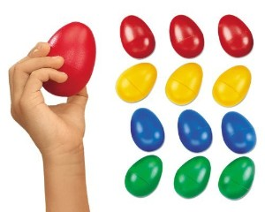
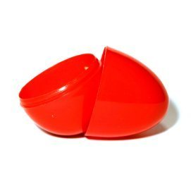


fizz
Appeal to Their Senses:
Form a Baby Band
BOOM
READ!
₊
₊
₌

Slide 26









fizz
BOOM
Exploring the Senses
READ!

Slide 27










Exploring our Senses:
Putting Touch into Words
fizz
Touch and Guess:
How does #3 feel? Which one feels soft? Which one feels cold? What about squishy?
BOOM
READ!
2
1
3
4
5

Slide 28




Exploring our Senses: Putting it Together
fizz
BOOM
READ!
Listen to music,
watch bubbles pop,
smell some flowers,
eat some cookies
& share a big hug!

Slide 29







fizz
Movement:
Bouncing,
Rolling Balls
BOOM
READ!

Slide 30







Basic Concepts:
Simple games to play with balls
Try using an inclined plane!
Hug the ball!
Roll, pass and bounce the ball!
Have a stroller relay!
3
Try out shape & number
bounce!
Make a basket!
2
1

Slide 31






fizz
Basic Concepts:
Things that Move & Go
BOOM
READ!

Slide 32




Using painter’s tape, make a road on the floor. Invite children to bring their own wheels to Storytime!
Basic Concepts:
Things that Move & Roll
Talk about which shapes roll and why. Ask them to try and roll a small box, a plastic egg and a ball.
Make a ball roll down the tracks with two wooden dowels and a stack of books. For slightly older youth, make the ball roll backwards by moving the dowels closer together as the ball reaches about 2/3rds of the way down. (This shifts the ball’s center of gravity).

Slide 33





fizz
BOOM
Movement:
Trains on the Go
READ!

Slide 34



fizz
Freight Train
Adapt for Colors, Numbers & ABC’s
BOOM
READ!

Slide 35



fizz
Demonstrate the wheel and axle!
A Simple Machine:
The Wheel and Axle
BOOM
Many things can be used, but here’s a quick way to make a simple machine!
READ!
Cut a hole the diameter of a paper towel tube in the center of a Chinet, or foam, plate .
wheel
axle

Slide 36









fizz
The Animal
Kingdom:
Go Wild
BOOM
READ!

Slide 37












fizz
Make and Take: a
Peek-a-Who Plate
BOOM
READ!
Print the Peek a Who leaf .pdf on green printer paper.
Fold a paper plate in half and cut out the eye hole.
fold
Open the plate and place it on the green leaf paper. Trace around the plate and eye hole.
Cut out the shape from the leaf paper.
5. Glue the leaf paper to the plate.

Slide 38














fizz
Love ZooBorns!
‘Resetting the Standard for Devastating Cuteness’
BOOM
READ!
Free ZooBorns mobile phone apps!
The newest, cutest baby animals from the world’s zoos and aquariums teach through sight, sound and touch!
ABC ZooBorns
for iPhone & iPad
(ages 2-7)

Slide 39







fizz
Simple Concepts:
Floating & Bubbles
BOOM
READ!

Slide 40








fizz
Consider yet another bubble party… because they’re a blast!
Bubbles:
Floating &
Popping
BOOM
READ!
Make a bubble wrap painting with toddlers!
Cover your work surface with a plastic trash bag.
Cut a rectangular piece of bubble wrap slightly smaller than your paper and adhere it to the work surface.
Parent and child will carefully apply paint to surface of the bubble wrap with a foam brush.
When bubble wrap surface is coated lightly with paint, align and place a piece of white paper over the painted area and gently rub the back of the paper to pick up the paint.
Gently pull away paper and set aside to dry.
Multiple prints may be made from one paint application.
Encourage families to explore bubbles at home, too, with this recipe for good, clean fun!
They will need: bubble bath soap, a pie pan or mixing bowl, food coloring, a straw, and water from the bath tub!

Slide 41





Bubble wrap was inspired by nature! Many creatures use bubbles for protection.
Did you know?
Explore
this further
with school age
youth!

Slide 42




fizz
Basic Concepts:
Growing &
Changing
BOOM
READ!

Slide 43












You will need:
Preparation varies with age group.
fizz
BOOM
green paper for Ellison die or hand cut leaf
hole punch,
washable marker glue stick and/or glue gun
½ sheet of brown construction paper
+
+
+
bumpy chenille sticks or for babies, textured yarn
READ!
Take home
Bob & Otto

Slide 44











fizz
Blast Off into
Outer Space
BOOM
READ!

Slide 45




fizz
Blast Off with this Rocket Craft
BOOM
READ!

Slide 46
fizz
Blast Off with this Rocket Craft
BOOM
Rocket Craft
READ!
Preparation:
Printing the rocket .pdf on an 8 ½ x 11” sheet of white cardstock yields one craft.
After printing, cut them out two at a time by folding each sheet on the dotted line.
Pre cut crepe paper strips in the following quantities for each craft:
Two Red - 5” long
Two Orange – 7-8” long
One Yellow- 10-12” long
At the program:
After coloring the rocket ship, tape the crepe paper strips to the bottom, back: yellow first, then the orange ones, and red last. Put glue on
the back of both rockets and press
them together. Add a string
for flying too!

Slide 47








fizz
Day . Night
Light . Dark
Color . Shadows
BOOM
READ!

Slide 48


fizz
Pixar’s
Day & Night
BOOM
READ!
http://www.youtube.com/watch?v=MRuURW_UXfw

Slide 49






fizz
Make an Owl Friend
BOOM
READ!
Consider using Wausau Astrobrights printer paper!

Slide 50













fizz
Be Wise
How would you have fun with light & dark?
BOOM
READ!

Slide 51

fizz
Meet back
in 10, please.
BOOM
READ!

