Slide 1


How to Apply for a
Special Category Grant
Historic Preservation
Grants Program

Slide 2
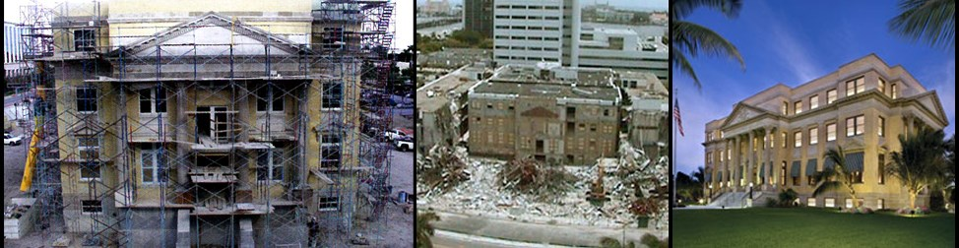
Grants Staff
Grants Supervisor:
Yasha Rodríguez, Ph.D.
Grants Specialists:
Kechia Herring, FCCM
Eric Case, M.A., FCCM
Drew Begley
Josh Gates

Slide 3
Department of State
Office of Cultural, Historical and Information Programs (OCHIP)
Division of Historical Resources (DHR)
Historic Preservation Grants Program

Slide 4
The Special Category Grants Program
is governed by
Chapter 267.0617, Florida Statutes
Chapter 1A-39, Florida Administrative Code
Special Category Grant Guidelines
the guidelines can be found on the grants webpage: dos.myflorida.com/media/694219/special-category-guidelines.pdf

Slide 5
Who is Eligible for A Special Category Grant
Eligible applicants
  Non-Profit Organizations
Public entities such as:
  Counties or Municipalities
  School Districts
  State Colleges or Universities
  Agencies of State Government
Ineligible Applicants
For-Profit Organizations
Individuals
Private Residences
  Note: The project site must be open and accessible to the general public.

Slide 6
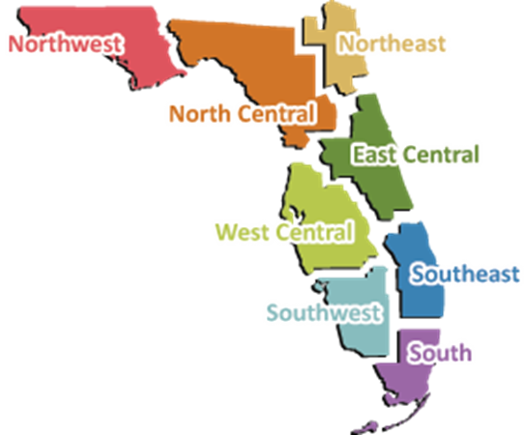
Recent Legislative Appropriations
Special Category Grants
FY 2017
FY 2016
FY 2015
FY 2014
$14 Million $8.28 Million
$14 Million
$1.89 Million

Slide 7
Special Category Grant Application Cycle
Submission Period opens:
May 15, 2017
Submission Period Closes:
  June, 15 2017, 5:00 p.m. EST
  Funding Availability:
  Applications will be evaluated on a competitive basis and the selected projects will be awarded funds beginning on July 1, 2018, for a 24- month period.

Slide 8
Grant Award and Match
Award
  Special Category grants provide assistance between $50,000 and $500,000.
  Your grant amount must be spent within two fiscal years.
Match
  The Applicant Organization is required to provide a matching share of either $50,000 or 50% of the grant award, whichever is greater; a minimum of 25% of this match must be cash.
  The remaining match may include in-kind services, volunteer labor, donated materials, and additional cash. Both grant award and match must be expended within the two year grant period.
  The match requirement is reduced for projects located in certain economically distressed areas.

Slide 9
Rural Economic Development Initiative
Applications for projects in REDI areas require only a 10% match.
REDI designation is available to counties and communities meeting specific economic distress factors.
REDI list is reviewed annually and is administered by the Department of Economic Opportunity.
For more REDI information visit www.floridajobs.org.
Contact:
Sherri Martin
850.717.8520
sherri.martin@deo.myflorida.com

Slide 10
Special Category Grant
Project Types

Slide 11
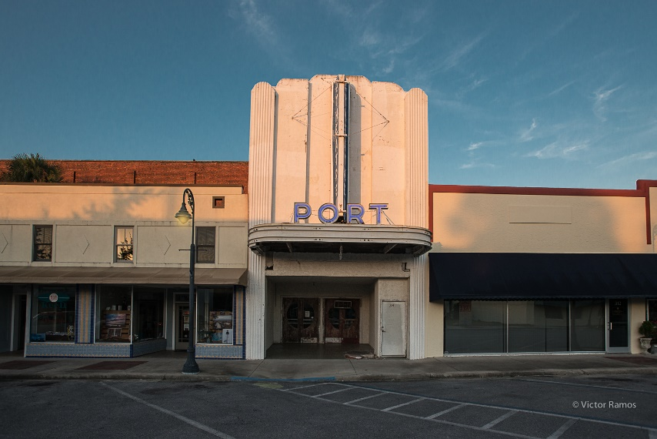
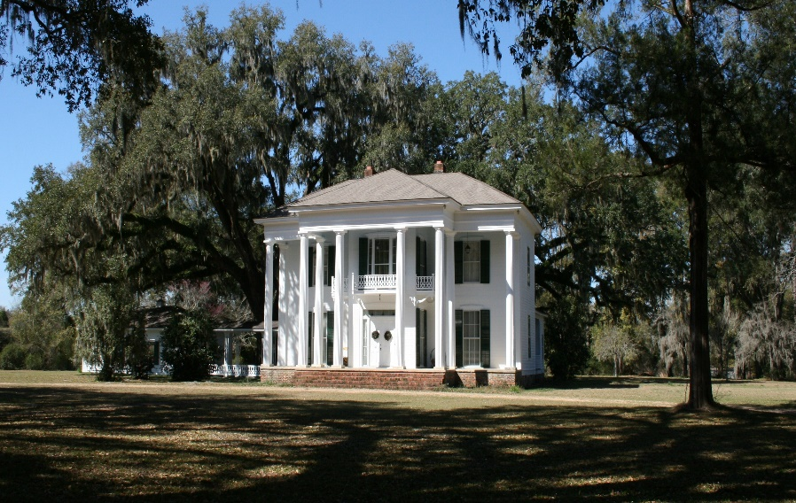
Acquisition
Acquisition of historical properties or archeological sites
Historic Port Theater Acquisition
Great Oaks Acquisition

Slide 12
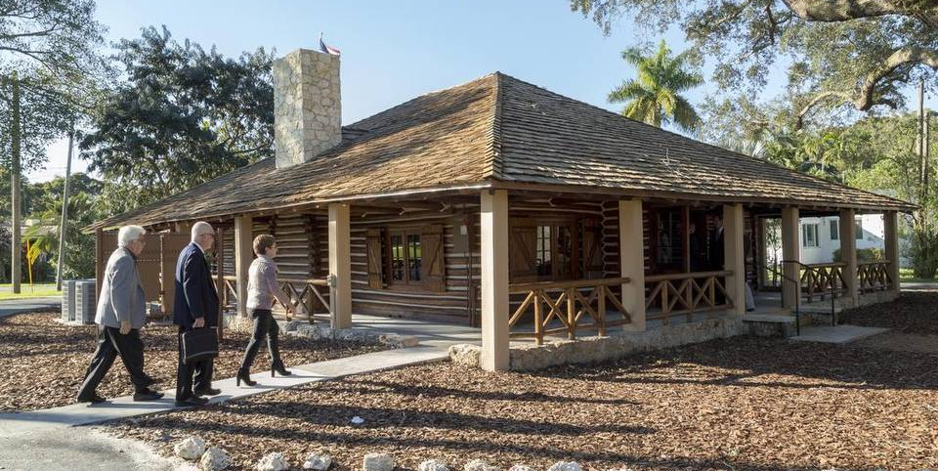
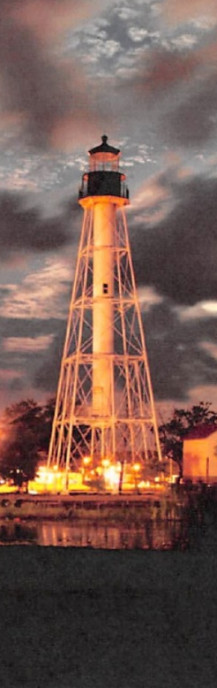
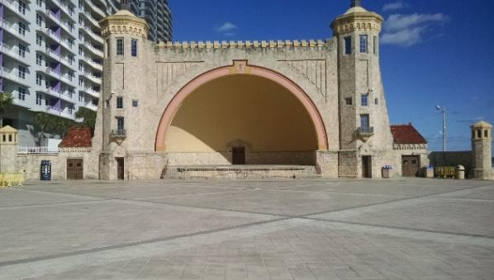
Development
Preservation
Restoration
Rehabilitation
Reconstruction
Stabilization of historical structures / archaeological sites
Preparation of measured drawings and records necessary to record historical and archaeological sites and properties
Historic Structure Assessments / Preservation Plans
Biscayne Park Log Cabin
Daytona Beach Bandshell
Cape San Blas Lighthouse Relocation
Notes:
12

Slide 13
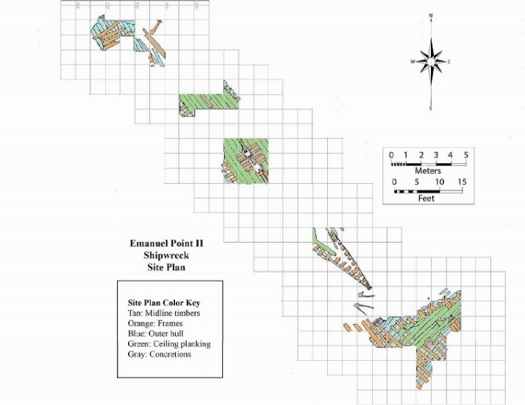
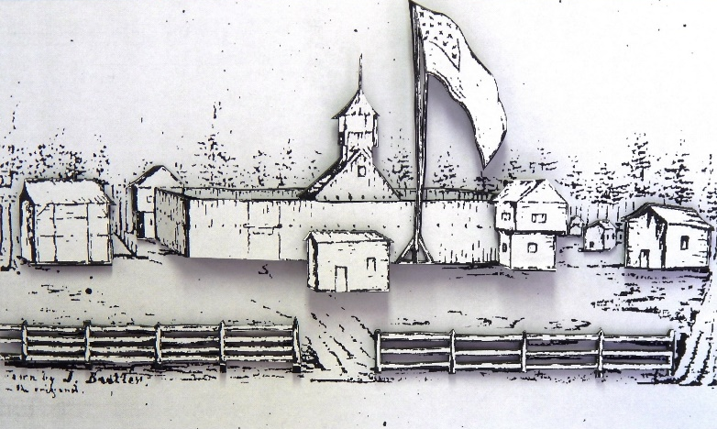
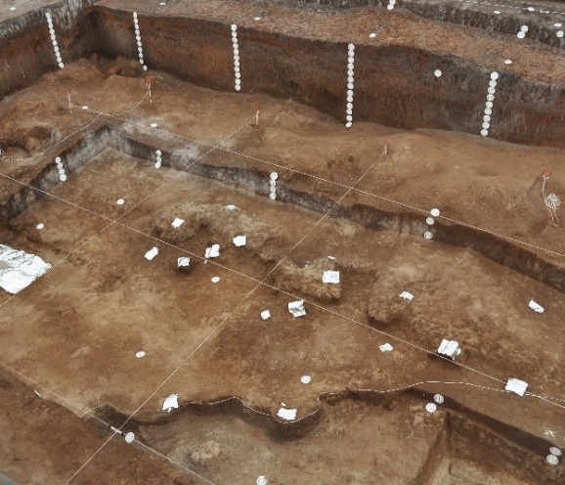
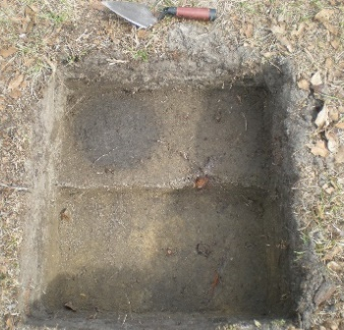
Archaeology
  Funds archaeological excavation projects
  Research
  Field Investigations
  Specialized Testing
  Analysis and Publication of Findings
Emanuel Point II Shipwreck
Fort King ca 1837
Old Vero Site Excavations
Fort King Site
Notes:
13

Slide 14
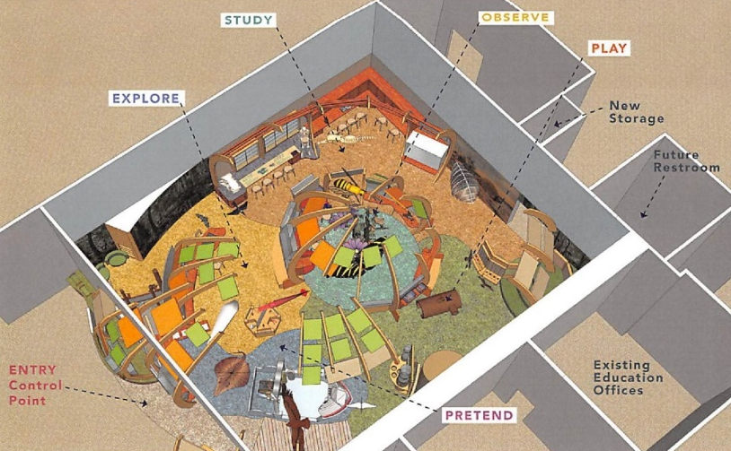
Museum Exhibits
Exhibit projects for Florida history museums
Research associated to the exhibit
Exhibit Design
Fabrication and Installation

Slide 15
Online Application
The DOS Grants online system can be
accessed at:
www.DOSgrants.com

Slide 16
Key Sections of the
Grant Application
Helpful Hints

Slide 17
Organization Information
The new online system will require applicants to create an organization profile and a personal profile for the individual preparing and submitting the application on behalf of the organization.
The system will prompt you as to how to begin your application.
Provide the required information such as designated project contract. This person and their contact email will used by the Division for all communication regarding the application.
Provide FEID number for the Application Organization.

Slide 18
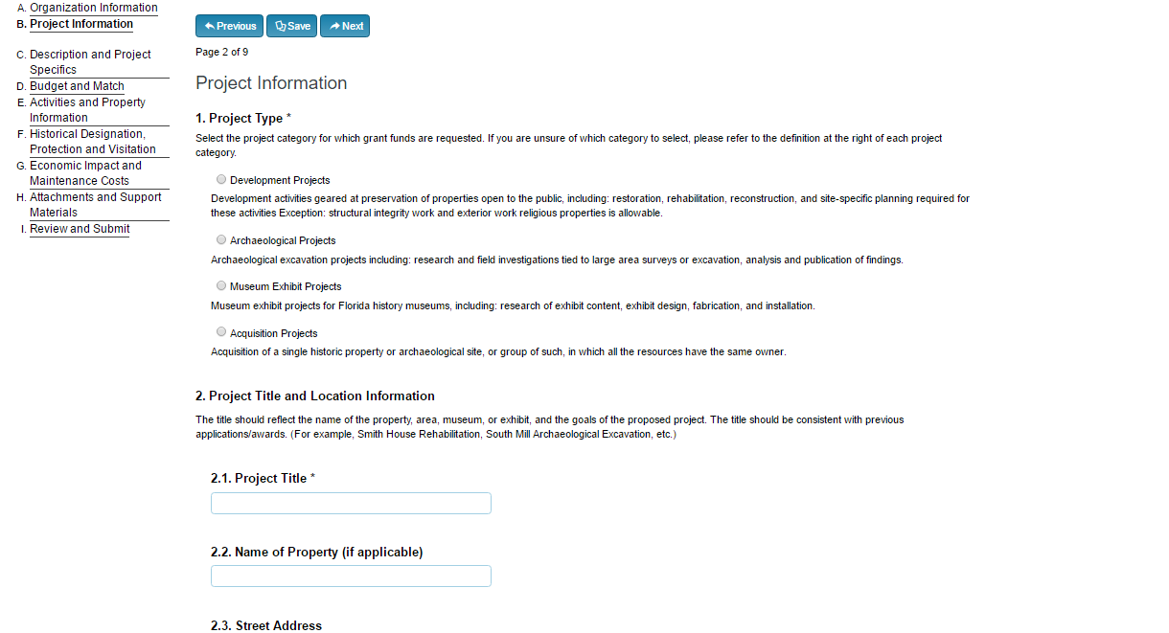
Project Type

Slide 19
Scope of work
Explain the proposed project by listing the specific items of work.
Describe in Detail:
what major elements you will be undertaking,
how will you accomplish those tasks, and
what the end product will be.
Note: For projects involving individual historic properties or archaeological sites, use the Activities and Property Information section to describe the historic significance of the property.

Slide 20
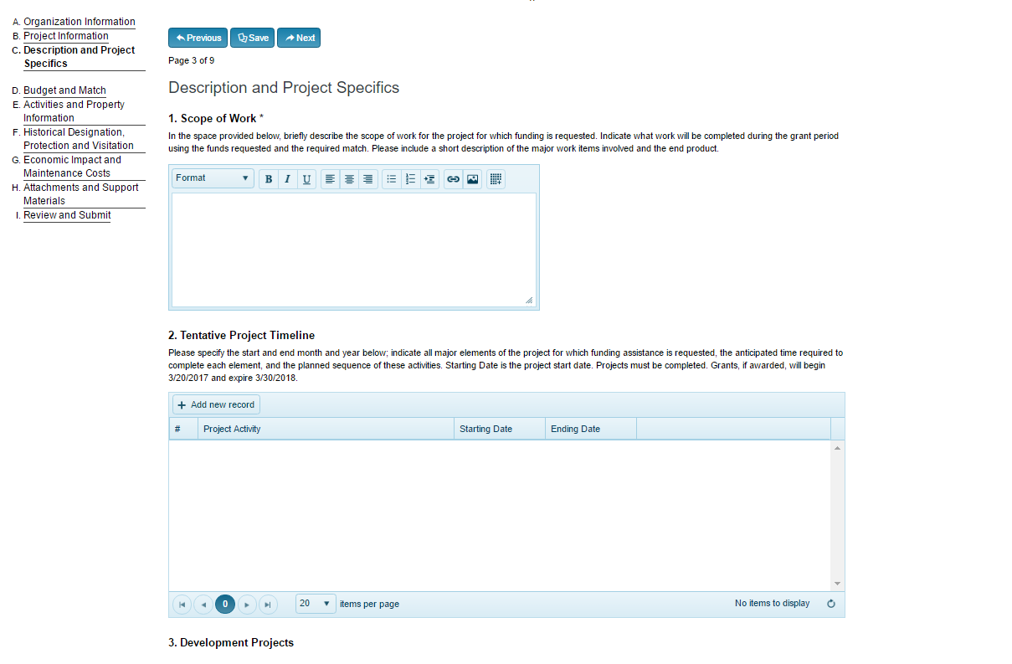

Slide 21
Tentative Project Timeline
Identify when major elements will be completed as the project progresses
Tentative Project Timeline Example
Project Element | Starting Date | Ending Date
Request for Proposal | July 2017 | August 2017
Hire Historic Architect | August 2017 | September 2017
50% Construction Documents | September 2017 | October 2017
100% Construction Documents | October 2017 | November 2017
Restoration work commence | November 2017 | February 2019
Restoration work completed | February 2019 | May 2019
Final Inspection and closeout report | June 2019 | June 2019

Slide 22
Budget and Match
Identify whether the items will be paid by the grant, paid by the applicant, or provided in-kind by the applicant.
Time dedicated to grant project by staff employed by the applicant is allowable as In-Kind Match and must be thoroughly documented during the grant period.
Identify the major components of the project: if multiple components will be carried out by the same entity, they can often be consolidated.
Most project budgets will not exceed 10 items.

Slide 23
ESTIMATED BUDGET EXAMPLE 1
Budget Item Number | Description | Grant Funds | Cash Match | In-Kind Match | Total
1 | Laboratory Testing | $6,000 | $0 | $0 | $6,000
2 | Roof repair/replacement | $33,000 | $17,000 | $5,000 | $45,000
3 | Masonry repair and restoration | $0 | $20,000 | $0 | $20,000
4 | Architectural Engineering and Conservation Services | $11,000 | $0 | $0 | $11,000
5 | Grant Administration | $0 | 8,000 | $0 | $5,000
 | TOTAL | $50,000 | $45,000 | $5,000 | $100,000
ESTIMATED BUDGET EXAMPLE 2
Budget Item Number | Description | Grant Funds | Cash Match | In-Kind Match | Total
1 | Archaeological Investigation | $44,000 | $10,289 | $91,491 | $144,052
2 | Project Blog/Webpage Support | $420 | $0 | $0 | $420
3 | Special Issue of Spyglass Magazine | $2,261 | $2,261 | $0 | $4,522
4 | Grant Administration | $4,994 | $0 | $0 | $4,994
 | TOTAL | $51,675 | $12,550 | $91,491 | $153,988

Slide 24
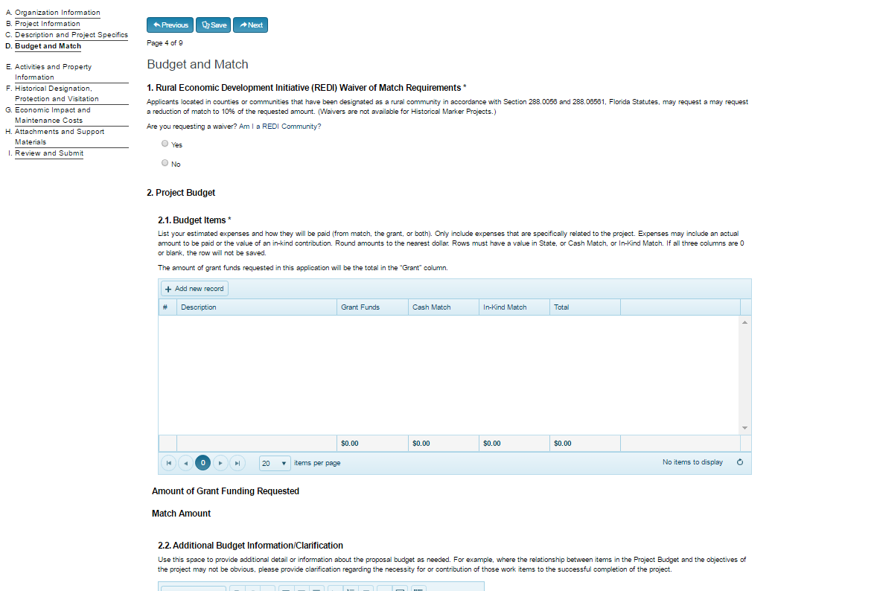
Budget and Match

Slide 25
Activities and Property Information
Provide a summary of the project-related activities completed at the time of application submittal, if any.
Such activities may include architectural studies or plans, preservation planning activities, archaeological research accomplished such as research design or previous excavation or site assessment work, or museum exhibit research and design.
Should they have already been completed, your printed architectural project schematics or construction documents or your museum exhibit research and design schematics must be uploaded with this application’s supporting materials.
Work that is completed before the grant period begins is not an eligible grant or match expense.
Activity Description | Date Completed | Cost/Value | Delete
Plans | 8/15/18 | $5,000.00
Example Table

Slide 26
Property or Site Significance
For projects involving individual historic properties or archaeological sites, describe the historical significance of the site.
Discuss whether the site is listed on, or may be eligible to be nominated to, the National Register of Historic Places.
Discuss any local designations of the site.
Note: There is no requirement of National Register listing to apply for our historic preservation grants, but please provide sufficient information to allow for historical significance to be fully evaluated.
Contact:
Florida Master Site File
850.245.6440
SiteFile@dos.myflorida.com
Flheritage.com/preservation/master-site-file/

Slide 27
Naming Attachments
All supplementary information must be uploaded to the online system as part of the application. No attachments will be accepted outside of the online system.
Please name each file to reflect its contents:
example: Monticello Main Photograph
example: Bandshell FMSF form updated
example: Children’s Museum brochure
If you have multiple documents (for instance photographs) for one attachment, combine them all into one single document and then upload as a single attachment.

Slide 28
Attachment: Documentation of Non-Profit Status
Non-Profit Organizations Only
All in-state corporate entities must provide documentation of their current registration as a Florida non-profit corporation with the Division of Corporations, Florida Department of State: SunBiz.org.
Out-of-state corporate entities must include documentation from the Internal Revenue Service confirming that they are exempt from federal income tax under section 501(c)(3) of the Internal Revenue Code.

Slide 29
Attachment: Documentation of Confirmed Match
Must contain documentation of all match
Documentation must include:
Cash-on-hand or pledges
  A letter from the local government manager or assistant manager, the chair of the commission, or the executive director of an non-profit organization (NPO).
  An organization can also provide a bank statement or letter from the grantee's financial institution.
  At least 25% of your total match contribution must be cash.
Note: Match that is not adequately documented will be disallowed, which will reduce the grant award amount. Applications with inadequate match may be determined ineligible.

Slide 30
Attachment: Documentation of Confirmed Match (continued)
  Volunteer Labor, In-Kind Services, or Donated Materials
    A detailed statement from the individual or entity making the donation should include a justification of the value or hourly rate.
    An explanation of how it will be used to fulfill the objectives of the project.
    For services or labor, estimate the numbers of work hours being pledged multiplied by the appropriate hourly wage.
Note: Match that is not adequately documented will be disallowed, which will reduce the grant award amount. Applications with inadequate match may be determined ineligible.

Slide 31
Attachment: Letters of Support, Endorsements, or Resolutions
Letters of support are not required, but are recommended.
If received after the deadline, these documents will be accepted if received at least one month prior to the Florida Historical Commission Meeting.
Although there is no limit, 10 letters are sufficient.
Form letters are discouraged.
Please address all letters to:
Dr. Timothy Parsons, Director
Division of Historical Resources
R.A. Gray Building, 4th Floor
500 South Bronough Street
Tallahassee, Florida 32399-0250

Slide 32
Attachment: Letters of Support, Endorsements, or Resolution (continued)
Cover sheet for this attachment
  Provide a cover sheet that includes a list of the letters of support, endorsements, or resolutions included in your application.
Please include in the list:
  Name of sender
  Type of communication (letter, petition, resolution, etc.)
  Organization represented (if applicable)
  Date of the item
Note: Remember to save cover sheet and letters as a single attachment then upload.

Slide 33
Attachment: Photographs
Applications must include images showing:
Existing conditions
General views of the site
Any visible archaeological features
Artifacts recovered from previous work (as applicable)
Images of relevant Museums or Exhibit Sites
For Development Projects, minimum requirements are:
Current photographs of all exterior elevations
Principal interior spaces
Significant architectural features
Provide historic photographs of the property (if available)
Cover sheet for this Attachment:
Either a PDF file or Word document
List the following for each photograph
  Property name and location
  Brief description
  Date of the image
Note: Photographs are important for all types of projects. Photograph submission guidelines can be found here:
http://dos.myflorida.com/media/696157/photo-guidelines.pdf

Slide 34
Attachment: Presentation Photograph
Important: designate one image as the principal view. This image will be shown in the public meeting.
Please provide
Property Name
Approximate date of the image

Slide 35
Attachment: Architectural Project Schematics and Construction Documents
FOR DEVELOPMENT PROJECTS ONLY
If completed submit architectural project schematics and construction documents in PDF format.

Slide 36
Attachment: Florida Master Site File Forms
SITE SPECIFIC PROJECTS ONLY
  Site-specific projects are projects for which work will be conducted on a single property, such as renovating an historic resource.
  Fill out and submit a Site File form with your application including a photo and map.
    If the property is previously recorded, provide a form update.
    If the property is not currently recorded, complete a new form.
  DO NOT resubmit copies of files that are already in Site File records.
Note: If requesting existing forms for reference, let the Site File staff know you are working on a grant application and allow two (2) weeks to process your request.

Slide 37
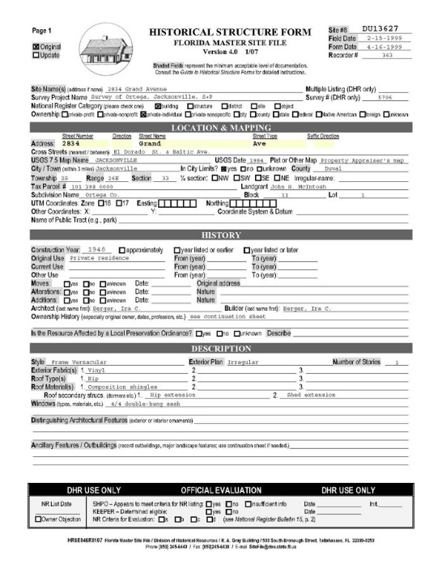
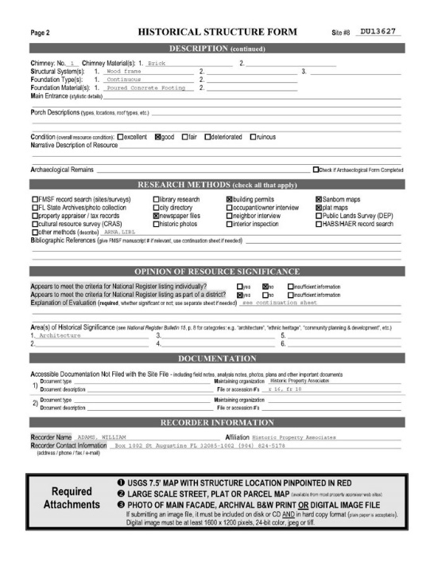
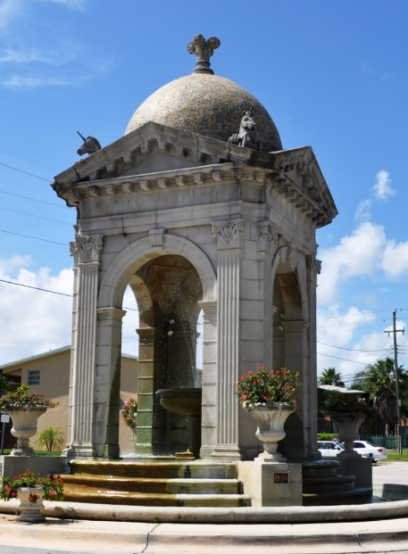
Note: If you need help completing the form, Site File staff are available to help.
Contact:
Florida Master Site File
850.245.6440
SiteFile@dos.myflorida.com
Flheritage.com/preservation/master-site-file/

Slide 38
Attachment: Documentation of Threat
  Provide meeting minutes, newspaper articles, photographs, and/or public notices showing immediate threats to the property
  Threats may include demolition, encroaching development, looting, vandalism, natural forces such as beach erosion and/or flooding, termite infestation, structural deficiencies, improper curatorial conditions, and exposure to the elements causing deterioration.
  Note: All projects should have something to provide here.

Slide 39
Attachment: Appraisal and Purchase Documents
ACQUISITION PROJECTS ONLY
Must include:
Complete appraisal(s) prepared by a Florida State Certified General Real Estate Appraiser. Two appraisals are required if the value of the first appraisal exceeds $500,000.
A title search
An executed option or purchase agreement
Property survey
A copy of a professional archaeological survey if the property is being proposed for purchase as a significant archaeological site

Slide 40
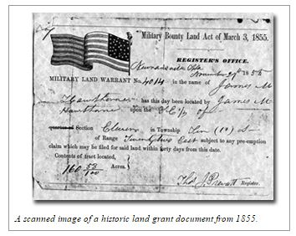
Attachment: Copy of Title Search
Acquisition Projects Only

Slide 41
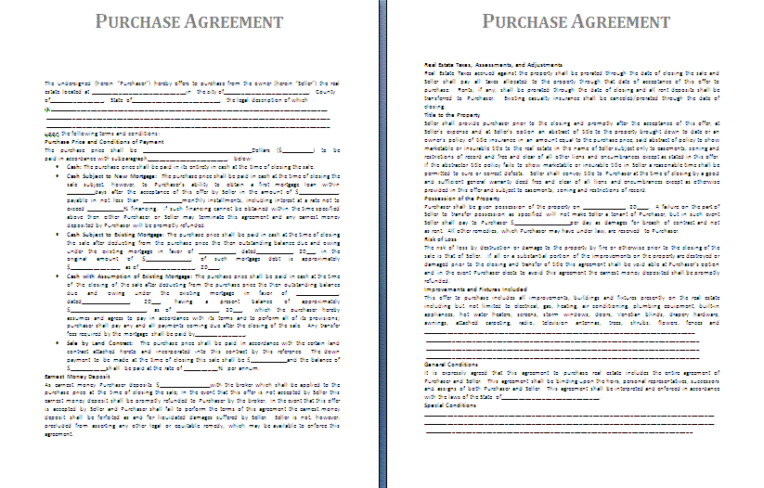
Attachment: Copy of Executed Option or
Purchase Agreement
Acquisition Projects Only

Slide 42
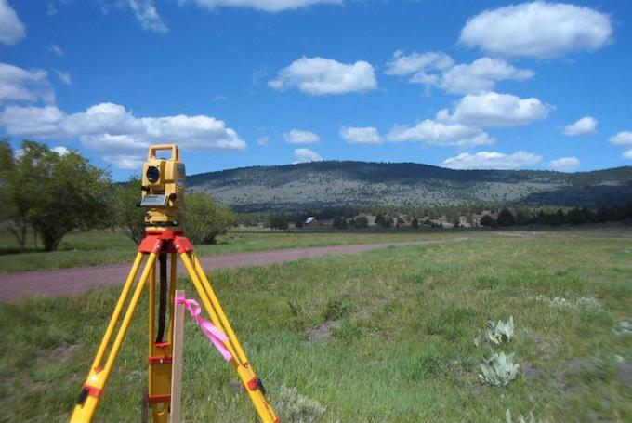
Attachment: Certified Land Survey
Acquisition Projects Only

Slide 43
Attachment: Archaeological Supporting Documents
Archaeological Projects Only
Previous archaeological site reports and surveys (if available).
Curriculum vitae for Principal Investigator and key personnel (if already selected).

Slide 44
Attachment: Exhibit Supporting Documents
Museum Exhibit Projects Only
Curriculum Vitae for all key project research and exhibit development personnel (if known).
Letters of confirmation from lending institutions if objects are to be loaned from other institutions or individuals for exhibit.
Letters of commitment from participating institutions if the exhibit is designed to travel.

Slide 45
Attachment: Local Protection
Provide documents that provide local protection of the project site (if any) such as:
  Local Protection Ordinances
  Preservation or Conservation Agreements
  Protective or Restrictive Covenants
  Maintenance Agreements

Slide 46
Attachment: Owner Concurrence Letter
Site-Specific Projects Only
Provide a letter documenting that the applicant has the permission of the owner of record (if the property owner is not the applicant).
This should show that the owner is supportive of this grant application and will allow this work to be conducted on the property.
The property owner must be a non-profit organization, local government, university, or agency of state government, except for acquisition projects or archaeological excavation projects.

Slide 47
Additional Supporting Materials
Applicants may use this attachment to add materials not specifically requested by the Division of Historical Resources that support the application, such as:
  Examples of previous work
  Organization brochures, articles, web pages
  Newspaper articles
Note: Items must be scanned and sent electronically file, so send only the best you have!

Slide 48
Completing the Application
The system will allow you to stop and save at any time while working on the application.
Once you have finished filling out your online application and are satisfied with your responses, hit the button marked “Submit.”
If there are any errors or issues the online system will identify them and require you to address them before submission.
An Applicant Organization may have no more than one (1) previously awarded grant from the Division (Special Category and Small Matching) open at the time of application.

Slide 49
Application Review
Process

Slide 50
  Division Staff Review
  Determines eligibility and compliance with program guidelines.
  Reviews Scope of Work and determines compliance and applicable Secretary of the Interior’s Standards.
  Provides technical guidance on specific issues.
  Reviews Budgets to confirm eligibility / appropriateness of expenses and Budget correlation to the Scope of Work.
  Confirms documented threats to the property (if applicable).
  Reviews appropriateness of the Tentative Project Timeline.
  Formulates staff recommendations and presents the project to the Florida Historical Commission for their consideration.
  Note: If clarification information is needed, you will be contacted and provided a deadline to respond.
Notes:
50

Slide 51
Panel Review and Scoring
Review and scoring by the Florida Historical Commission will take place at a public meeting.
Each commissioner will complete preliminary scoring for every application before the meeting.
Commissioners can change their evaluations after discussing each application individually during the meeting, and will finalize their scores after all grant application discussions are complete.
The applications will then be ranked based on an average of the commissioners’ scores.
The final ranked list will be submitted to the Secretary of State for approval and then to the Legislature for funding consideration.

Slide 52
Evaluation Criteria (10 total)
The commission will evaluate applications by these 10 criteria. Each criteria will be judged on a 10 point scale.
Criteria relating to project site / area
    Historic significance
    Endangerment
    Appropriateness of project proposal
Criteria relative to applicant
    Administrative capabilities
    Adequate financial resources
    Availability of professional and technical resources
Criteria related to public benefit
    Compatibility with statewide historic preservation priorities
    Educational potential
    Economic benefit
    Public use or benefit

Slide 53
Funding Process

Slide 54
Application Timeline
APPLICATION
SUBMISSION AND REVIEW
DHR Staff reviews applications for eligibility and conducts technical reviews.
PUBLIC MEETING
REVIEW AND RANKING
Florida Historical Commission reviews and scores projects; recommends them to the Secretary of State.
SECRETARY OF STATE
The Secretary of State approves the recommended projects list and submits the total recommended award amount to the Legislature as part of the budget request for the upcoming fiscal year.
Legislature
The Legislature negotiates a final budget and submits it to the Governor for signature
APPROPRIATION
Governor either approves or vetoes line items and then signs the budget. Grantees are notified and Grant Award Agreements are prepared for review
July 1
If funded, grant funds become available

Slide 55
Grants Management Webinar
Once the grant cycle starts, we will host a “How To Manage Your Grant” webinar workshop where we will discuss important details of your grant including:
  Grant Award Agreement
  Deliverables
  Expectations
  Deadlines
  Reporting
  Requesting payment
  Close-out

Slide 56
For Additional Information
Physical Address:
Division of Historical Resources
R.A. Gray Building, 4th Floor
500 S. Bronough St.
Tallahassee, Florida 32399
Division Contact:
1.800.847.7278 or 850.245.6333
Grants Staff Contact:
Yasha Rodríguez, Historic Preservation Supervisor
850.245.6362 yasha.rodriguez@dos.myflorida.com
Kechia Herring, Historic Preservation Grants Specialist
850.245.6310 kechia.herring@dos.myflorida.com
Eric Case, Historic Preservation Grants Specialist
850.245.6338 eric.case@dos.myflorida.com
Josh Gates, Historic Preservation Grants Specialist
850.245.6355 joshua.gates@dos.myflorida.com
Drew Begley, Historic Preservation Grants Specialist
850-245-6466 drew.begley@dos.myflorida.com

Slide 57


