Slide 1
Every Hero
Has a Story
Early Literacy

Slide 2
Hero Inside Me
Lots of music and movement
Look what I can do!
Cool Tricks!
Self-portrait
Heroes in My Family
Big and little hands
Baby/Toddler Obstacle Course
Highlight members of the family
Hero Medals
Heroes at School/Community/Feel Better
Let’s get ready for school!
Learning about safety
Toy Clinic
X-Ray Craft
Heroes Save the World/Animal Heroes
Gardens, trees, flowers
Read to dogs
Heroes in Stories
Mustache Baby
Superhero photos
Dress Up Storytime

Slide 3
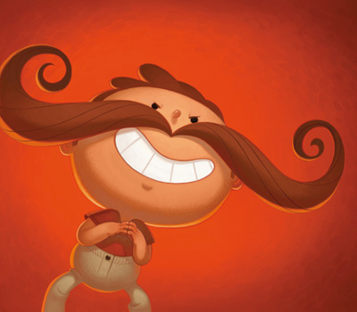
Mustache Storytime!
Mustache Baby and more…
Mustache poem
Mustache Apps
Stickers and face paint
Animal mustaches

Slide 4
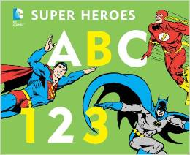
Booktalks…

